Slide 1

Enabling Remote work Microsoft
Bring your teams together effectively

Slide 2
Simple Steps to Enabling Remote Productivity
Ready – Ready your environment and Mobile User’s Device
Communicate - Communicate remote work guidance to your employees
Train - Provide user guides and training contents
Change - Start using Teams to change the way you work

Slide 3
Ready your environment
Enable Teams, Yammer and Microsoft Stream
Configure Audio-Conferencing for dial-in
How to ready your network
How to deploy app templates in Teams
How to pin apps in Teams for end-users: extensible points in Teams client
Move essential team files from Share Drives to Microsoft Teams Sites

Slide 4
Ready your User’s Mobile/Personal Device
Move individual/essential “H: Drive” files to OneDrive
Install, sign-in, and configure mobile apps
Microsoft Teams
OneDrive
Outlook
Yammer
Word/Excel/PowerPoint
Stream
Intune, add. Ensure all apps above are manageable by Intune. SP add to list. Ask Eric what personal drives are at Advent.

Slide 5
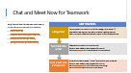
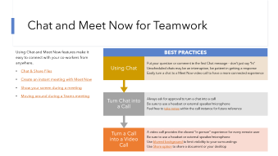
Communicate remote work guidance to your employees
Setup corporate communications model, feedback mechanism and survey/polls to gauge remote worker sentiment
Use Company Communicator app in Teams to communicate on latest updates and broadcast guidance to all your employees (See apps section)
Use FAQ Plus bot to provide proximity assistance with frequently asked questions on the situation (See apps section)
Example of guidance
Maintain social interactions
Use one to one or group chat
Reachability
Update your status message in Teams
Minimize distraction
Have a dedicated “quiet” workspace
Set yourself a schedule and include breaks
Best practices on efficient meetings
Do instant meetings with “Meet Now”
Activate video and use background blur
Keep your calendar up-to-date with dedicated meeting times/travel times
Set your agenda visible for your teammates
Mute private/social apps

Slide 6
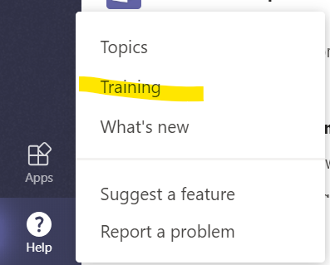
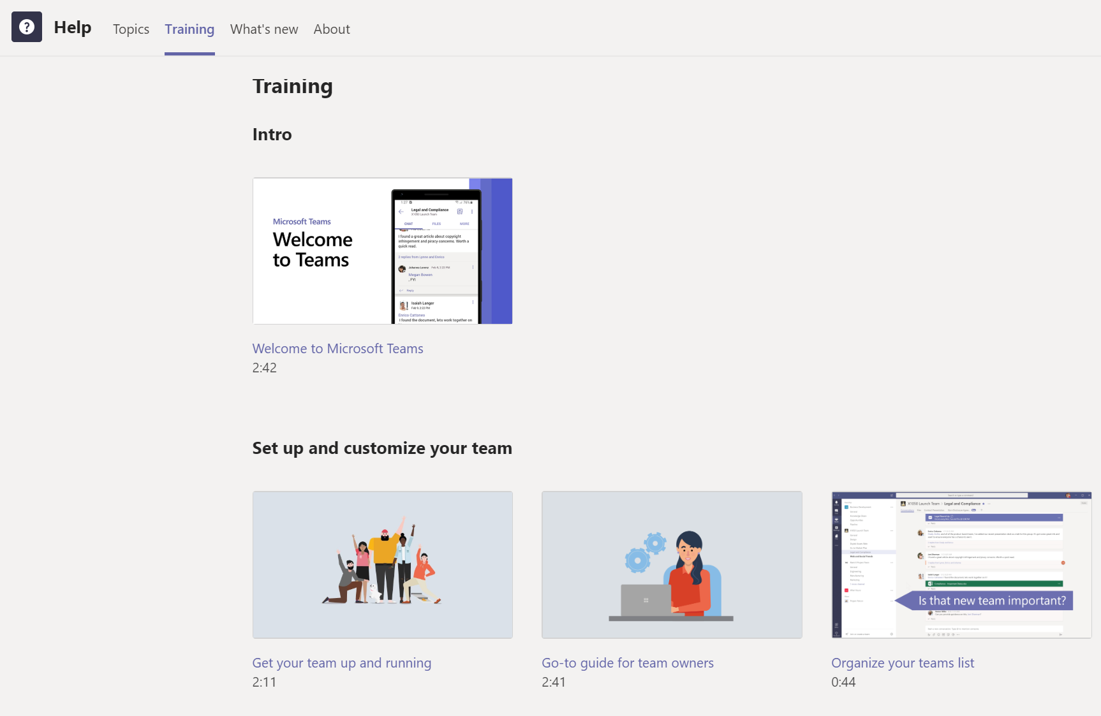
Provide user guides & training content
Deploy learning pathways to provide Teams training content in your Intranet
Publish “learning Pathway” as an app in Teams for immediate access for your employees
End User Training content
Welcome To Teams
Teams Quick Start
Teams Training Videos
Teams Training Channel on YouTube
Get Help and How-To Documentation in the Teams Help Center
Instructor-led training for Microsoft Teams
Say hello to Microsoft Teams
Get Started With Microsoft Teams
Run Effective Meetings with Microsoft Teams
Learn tips for taking Microsoft Teams to the next level
Learn To Use Apps In Teams
Empower your Firstline Workers with Microsoft Teams
Teams Upgrade Planning workshops
Guide your employees to use “Help” button in Teams for training content

Slide 7
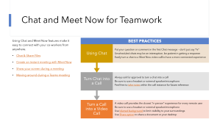
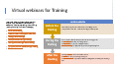
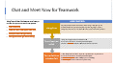
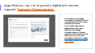

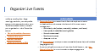
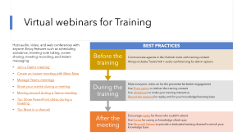
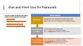
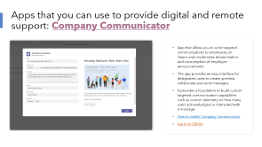
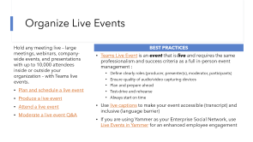
Start using Teams to change the way your work
Before
Now
Office Interaction
In-person meetings
In-person trainings (up to 250)
Town Hall events (up to 10,000)
Face-to-Face support
Chat or Meet Now
Virtual meetings
Virtual webinars
Live Events
Virtual support

Slide 8
Chat and Meet Now for Teamwork
Using Chat and Meet Now features make it easy to connect with your co-workers from anywhere.
Chat & Share Files
Create an instant meeting with Meet Now
Show your screen during a meeting
Moving around during a Teams meeting
BEST PRACTICES
Using Chat
Put your question or comment in the first Chat message – don’t just say “hi”
Unscheduled chats may be an interruption, be patient in getting a response
Turn Chat into a Call
Always ask for approval to turn a chat into a call
Turn a Call into a Video Call
A video call provides the closest “in person” experience for every remote user
Be sure to use a headset or external speaker/microphone
Use blurred background to limit visibility to your surroundings
Use Share option to share a document or your desktop
Easily turn a chat to a Meet Now video call to have a more connected experience
Be sure to use a headset or external speaker/microphone
Feel free to take notes within the call instance for future reference

Slide 9
Virtual Meetings for Teamwork
Host audio, video, and web conferences with anyone. Enjoy features such as scheduling assistance, meeting note taking, screen sharing, meeting recording, and instant messaging
Join a Teams meeting
Create an instant meeting with Meet Now
Manage Teams meetings
Show your screen during a meeting
Moving around during a Teams meeting
Tip: Show PowerPoint slides during a meeting
Tip: Meet in a channel
BEST PRACTICES
Before the meeting
Communicate agenda in the Outlook invite with clear purpose
Use FindTime or Calendar visibility to plan at an appropriate slot
Always includes Teams link + audio-conferencing for dial-in options
During the meeting
Take shared notes
Turn video on and mute yourself by default to avoid background noise
Use Share option to share document/desktop
Record the meeting for replay in case everyone cannot join
Join the meeting with your mobile phone
After the meeting
Drive recap and next steps in Teams
Share the link to shared notes in Teams
Use planner to drive team tasks
Encourage replay for those who couldn’t attend
Share materials ahead using Teams

Slide 10
Virtual webinars for Training
Host audio, video, and web conferences with anyone. Enjoy features such as scheduling assistance, meeting note taking, screen sharing, meeting recording, and instant messaging
Join a Teams meeting
Create an instant meeting with Meet Now
Manage Teams meetings
Show your screen during a meeting
Moving around during a Teams meeting
Tip: Show PowerPoint slides during a meeting
Tip: Meet in a channel
BEST PRACTICES
Before the training
Communicate agenda in the Outlook invite with training content
Always includes Teams link + audio-conferencing for dial-in options
During the training
Mute everyone, video on for the presenter for better engagement
Use Share option to deliver the training content
Use whiteboard to make your training interactive
Record the meeting for replay and for your knowledge/learning base
After the meeting
Encourage replay for those who couldn’t attend
Use Forms for survey or knowledge check quiz
Use Microsoft Stream to provide a dedicated training channel to enrich your knowledge base

Slide 11
Organize Live Events
Hold any meeting live – large meetings, webinars, company-wide events, and presentations with up to 10,000 attendees inside or outside your organization – with Teams live events.
Plan and schedule a live event
Produce a live event
Attend a live event
Moderate a live event Q&A
BEST PRACTICES
Teams Live Event is an event that is live and requires the same professionalism and success criteria as a full in-person event management :
Define clearly roles (producer, presenter(s), moderator, participants)
Ensure quality of audio/video capturing devices
Plan and prepare ahead
Test-drive and rehearse
Always start on time
Use live captions to make your event accessible (transcript) and inclusive (language barrier)
If you are using Yammer as your Enterprise Social Network, use Live Events in Yammer for an enhanced employee engagement

Slide 12
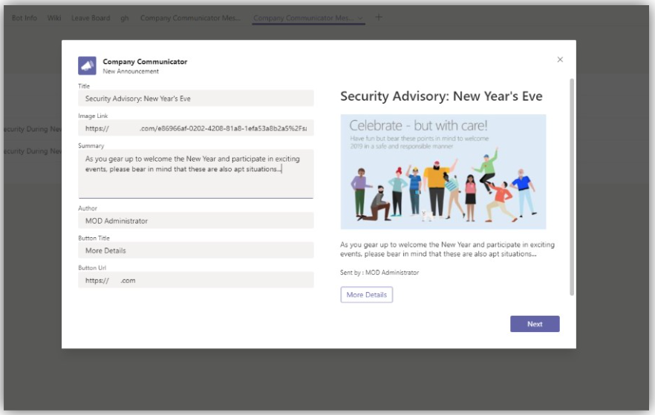
Apps that you can use to provide digital and remote support: Company Communicator
App that allows you to send targeted communications to employees on Teams and modernizes dissemination and consumption of employee announcements.
The app provides an easy interface for designated users to create, preview, collaborate and send messages.
It provides a foundation to build custom targeted communication capabilities such as custom telemetry on how many users acknowledged or interacted with a message.
How to enable Company Communicator
Get it on GitHub

Slide 13
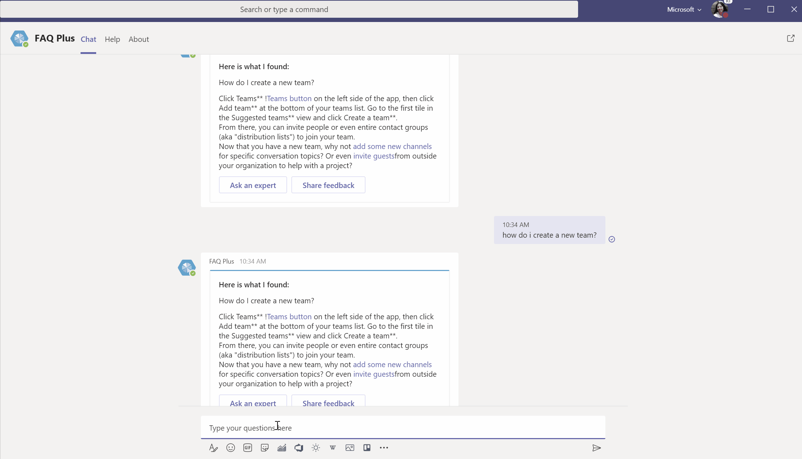
Apps that you can use to provide digital and remote support: FAQ Plus
App template and a friendly Q&A bot that answers commonly asked questions.
It comes pre-populated with commonly asked questions about Teams and can be easily customized to match your unique needs - no coding necessary.
Get it on GitHub

Slide 14
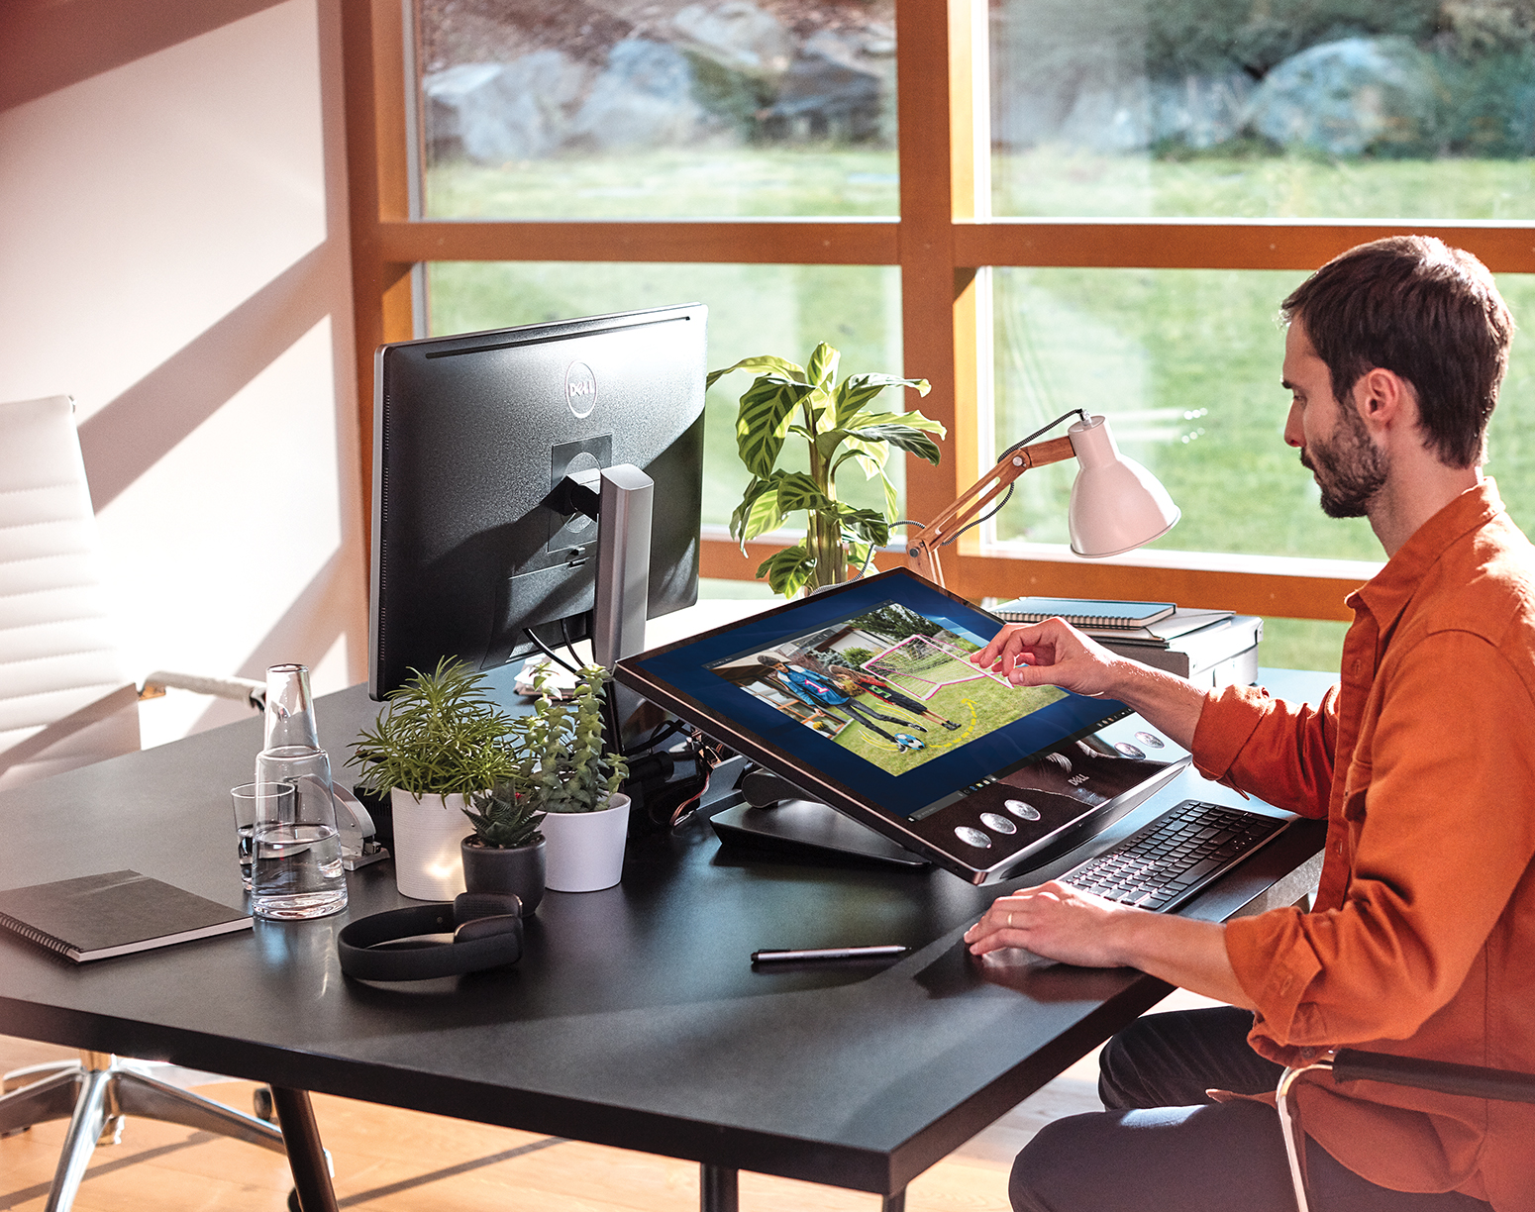

Remote working tips
How To’s for the Remote Worker

Slide 15
The content on the following slides is a collection of ideas from Microsoft employees and not an official guidance by Microsoft.

Slide 16
How to maintain social interactions
Instead of calling with voice only, activate the video
Have a chat / channel which is dedicated for some interactive fun (GIFS, jokes, etc.)
Replace min. 1 e-mail with a phone call a day

Slide 17
How to Manage Your Availability
Set your status accordingly in Microsoft Teams
Block and Label time Slots in your shared calendar when others can reach you
Set your calendar to visible for your colleagues in general

Slide 18
How to Minimize Distractions
Define your own working rhythm and put it into your calendar
Try not to mix Living and working space (working in the kitchen)
Mute private / social apps
Arrange a «quiet space» if you don’t live home alone. Discuss with co-occupants in advance
Plan home related chores (plumber visit, etc.) to non-office hours or a different day

Slide 19
Enjoy the flexibility and ...
Enjoy the extra sleep in the morning
No rush hours
Enjoy your own playlist
Get more family time
No ties or heels
Enjoy your own diet

